Slide 1
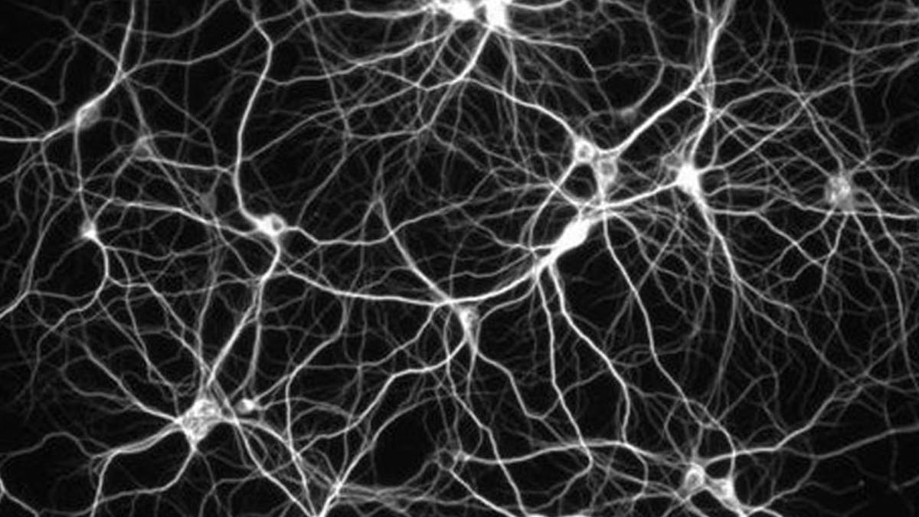

Slide 2
Artificial Neural Networks

Slide 3
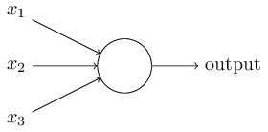
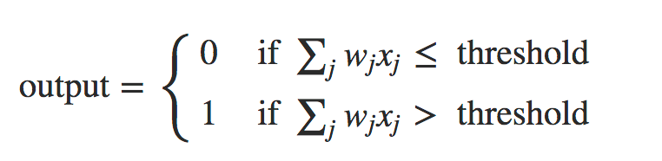
Artificial Neural Networks
Perceptron
Artificial Neuron Model
In the example shown, the Perceptron has three inputs: x1, x2, x3. Rosenblatt proposed a simple rule for calculating the output. He introduced weights, w1, w2, …, real numbers expressing the importance of the respective inputs to the output. The output of the neuron, 0 or 1, is determined by the weighted sum, Σjwjxj, smaller or larger than some threshold value (threshold). Like weights, threshold is a real number that is a parameter of the neuron. To put it in more precise algebraic terms:

Slide 4
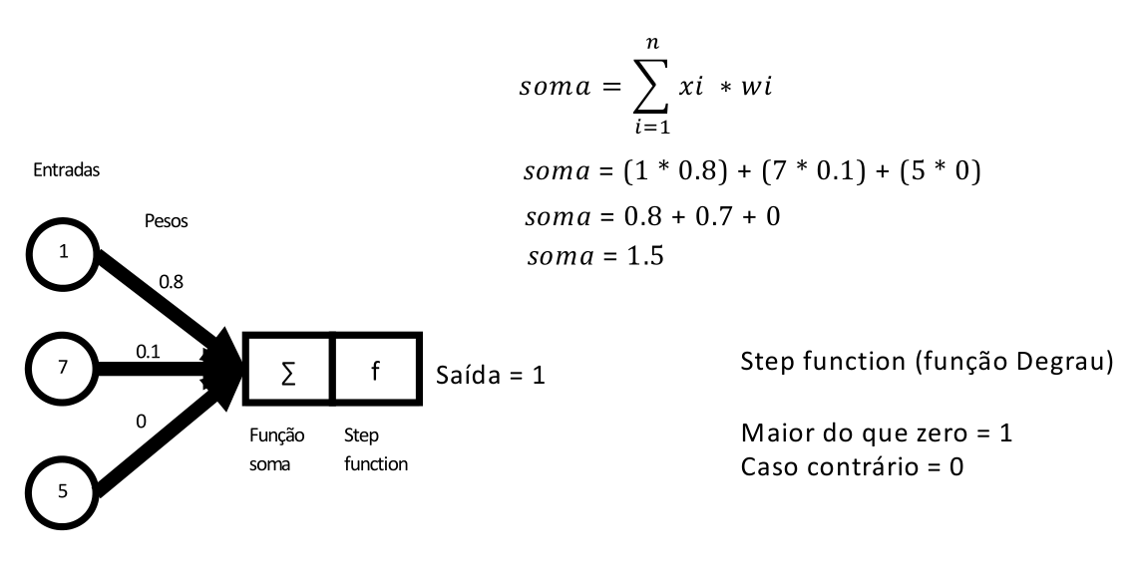
Artificial Neural Networks
Sum Function
Input
Weight
Output = 1
(If f > 0) = 1
(If f =<0) = 0
Sum
Function
Step
Function

Slide 5
Artificial Neural Networks
Step Function
Input
Weight
Output = 1
(If f > 0) = 1
(If f =<0) = 0
Sum
Function
Step
Function

Slide 6
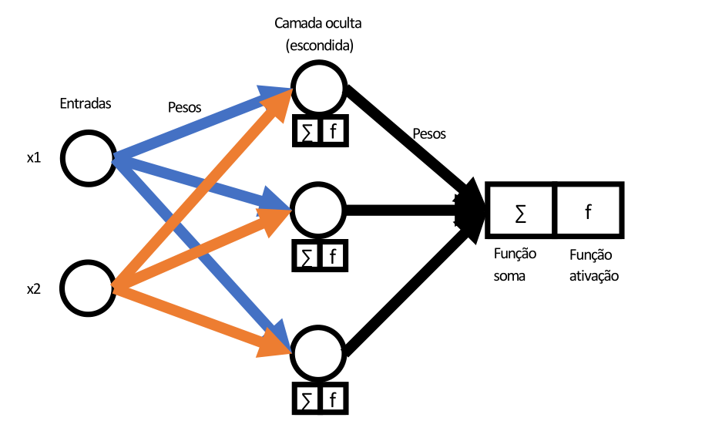
Artificial Neural Networks
Multilayer Perceptron
Hidden Layer
Weight
Weight
Output
Input
Sum
Function
Step
Function

Slide 7
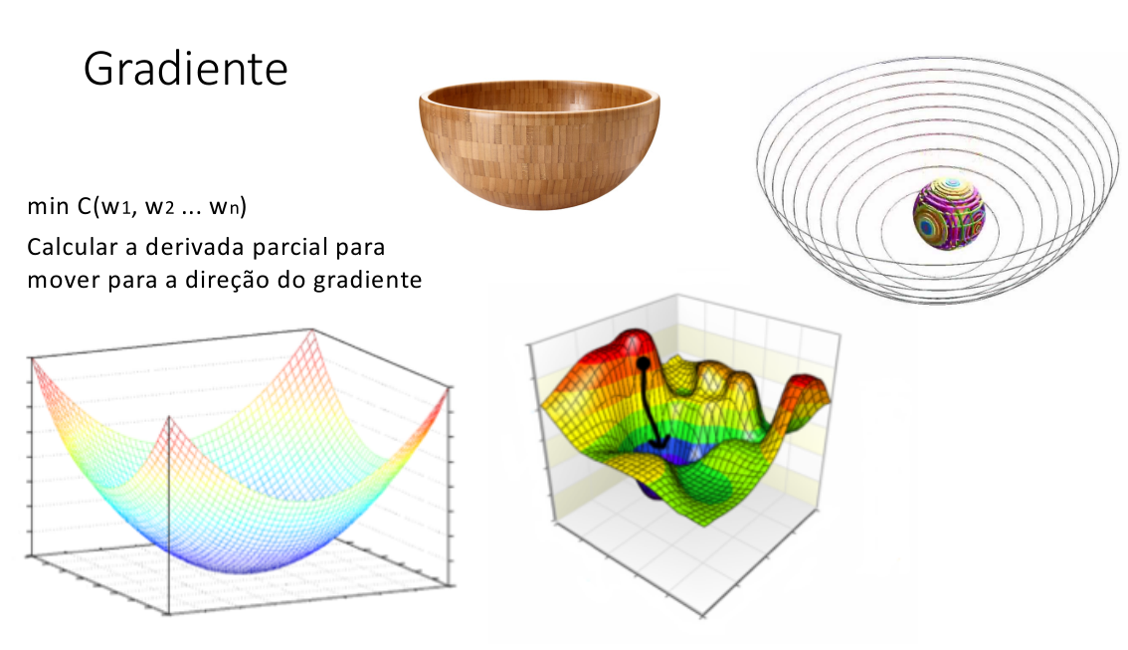
Artificial Neural Networks
Gradient Descent

